Slide 1
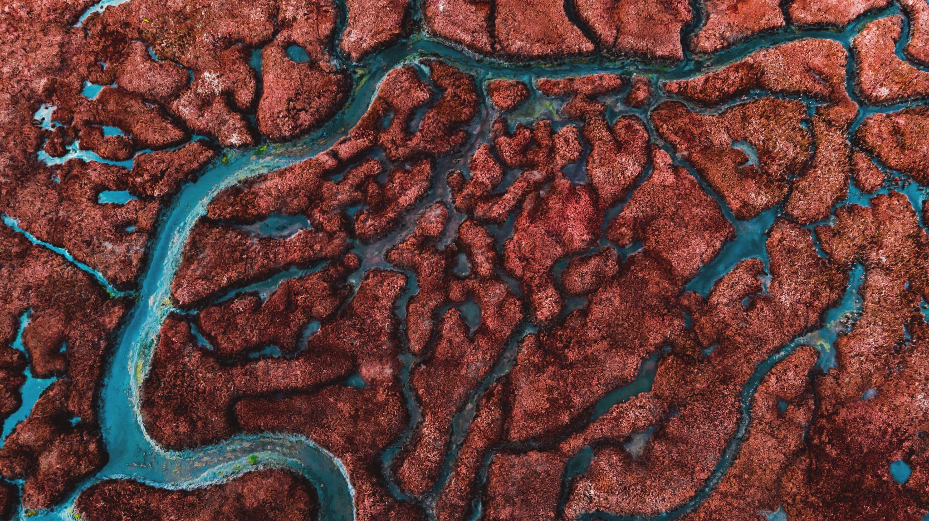
Decomposition
How Matter is Reused in Ecosystems

Slide 2
Nonliving organic matter includes things like organic waste and dead organisms and contains many of the same molecules living organisms have.
Decomposition is the process through which these complex molecules break down into simpler ones that can enter back into the food web

Slide 3
Two Kinds of Decomposition
Aerobic
Anerobic
Chemical process uses oxygen
Chemical process does not use oxygen
Notes:
A good time to point out this is a lot like cellular respiration, another process in which a complex chemical becomes simpler.

Slide 4
Anerobic decomposition
Occurs where oxygen is not present
Carried out by specialized bacteria that do not require oxygen.
Byproducts are methane, sulphureous gasses, and a complex organic leftover called “humus”

Slide 5
Occurs naturally in wetlands
Bogs and Marshes

Slide 6
…But it also occurs in landfills when food is thrown away
This produces about 6% of all green house gas emissions by humans

Slide 7
Aerobic Decomposition
Occurs anywhere where oxygen is present
Carried out by a variety of fungi, bacteria, and animals such as worms
Results are carbon dioxide, and humus

Slide 8
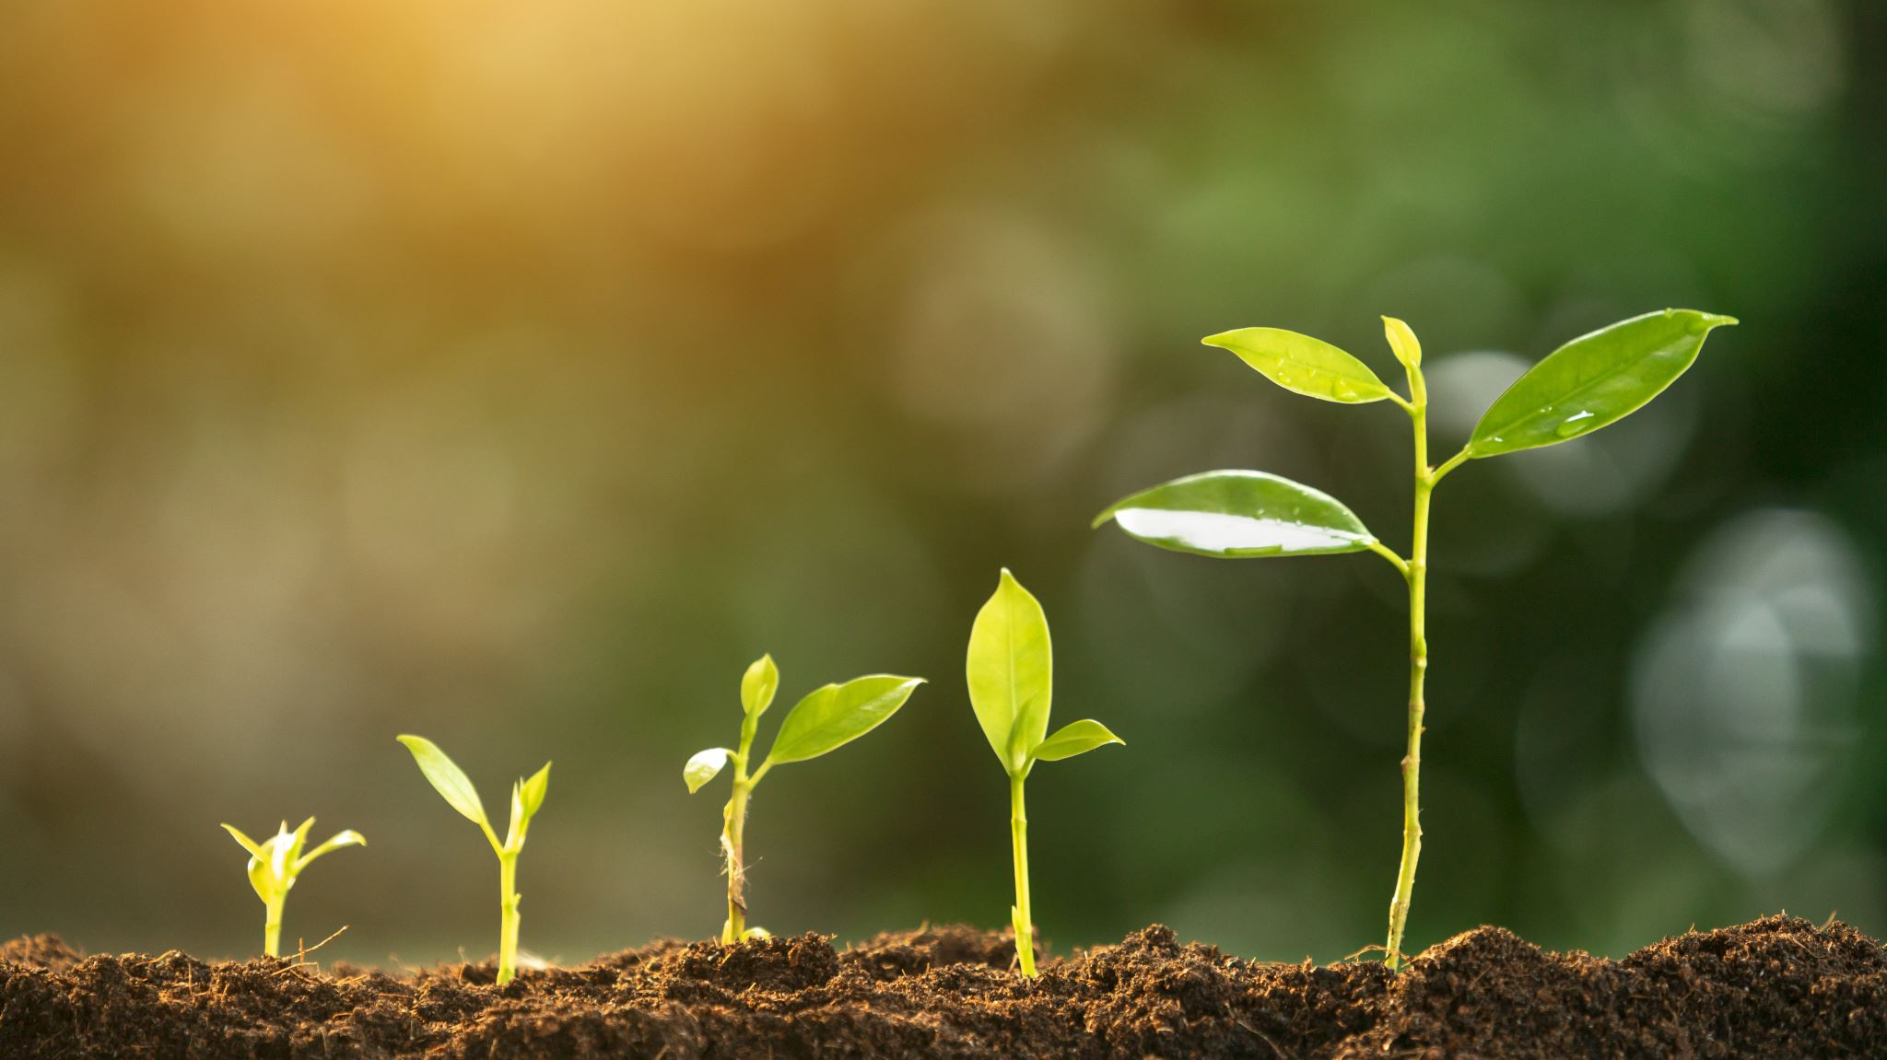
This occurs when we compost!

